Slide 1
Energy Consumption Analysis

Slide 2
Objective:
To analyse energy usage and greenhouse gas (GHG) emissions of Ontario's Broader Public Sector (BPS) organizations, leveraging a comprehensive database of reported data. We aim to identify trends, assess conservation effectiveness, and pinpoint areas for improvement, informing data-driven strategies to achieve climate change mitigation goals within the BPS

Slide 3
TECHNOLOGIES USED:
Python
EDA
Visualisation PowerBI

Slide 4
STEPS DONE IN THE PROJECT
Understanding problem statement
Data Extraction:
  Energy use and greenhouse gas emissions for the Broader Public Sector - Dataset - Ontario Data Catalogue this link is used to collect the necessary data to achieve our objective
  Data has been collected for the years 2012 to 2021
Data cleaning:
  Since it’s a real world data its not in proper format ,in order to clean this data set
    Python and
    MS-excel was used
  Once data for various year is cleaned it is concatenated as a single file
Exploratory Data Analysis:
  This is done to understand the data
  For feature relationship
  Feature selection
  Getting business insights etc..
Visualisation:
  Done using PowerBI

Slide 5
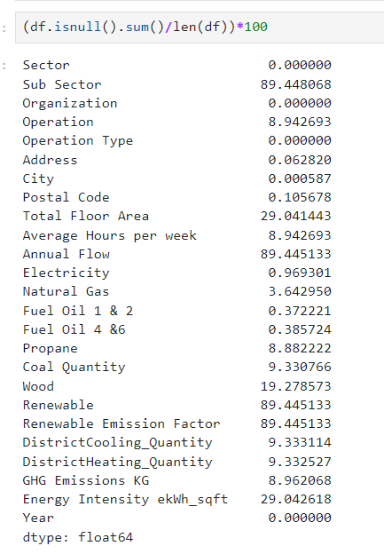
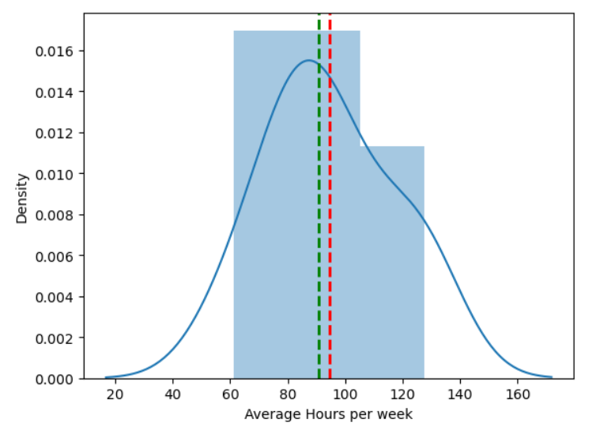
EDA INSIGHTS:
Null imputation:
Dropping columns
In the original data set many columns has null value of more than 70%
Dropping those column wont affect our target so those columns were removed from the file
Null imputation for other columns less than 70%:
Done using:
Mean replacement – mean is calculated by grouping each sector
Median replacement – median is calculated by grouping each sector
Bfill and ffill for categorical data
After null imputation columns turn normally distributed→

Slide 6
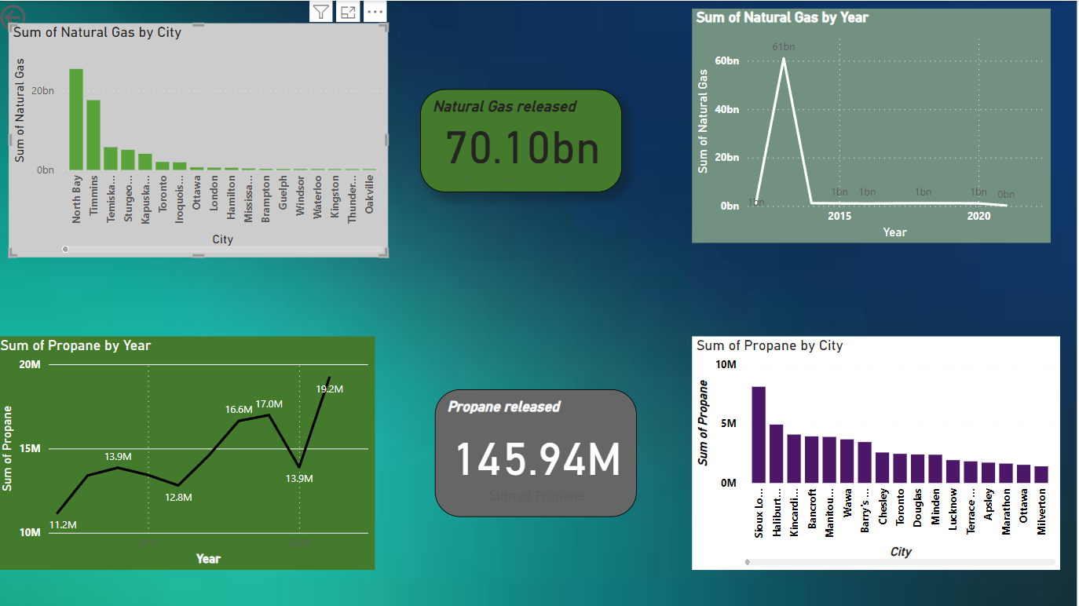
Natural Gas and Propane:
Usage of natural gas has increased in 2013 but got rapidly decreases in the upcoming years
Usage of propane was steadily increasing from 2012
The above diagrams also shows the details of both its usage as per cities , from that we come to know which city is the top users.

Slide 7
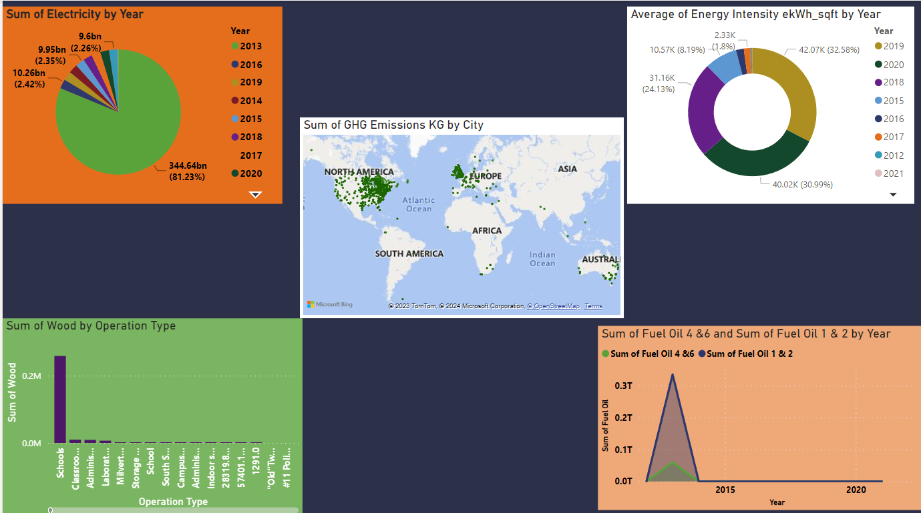
Electricity ,Fuel oil and GHG emission:
Year wise
City wise

Slide 8
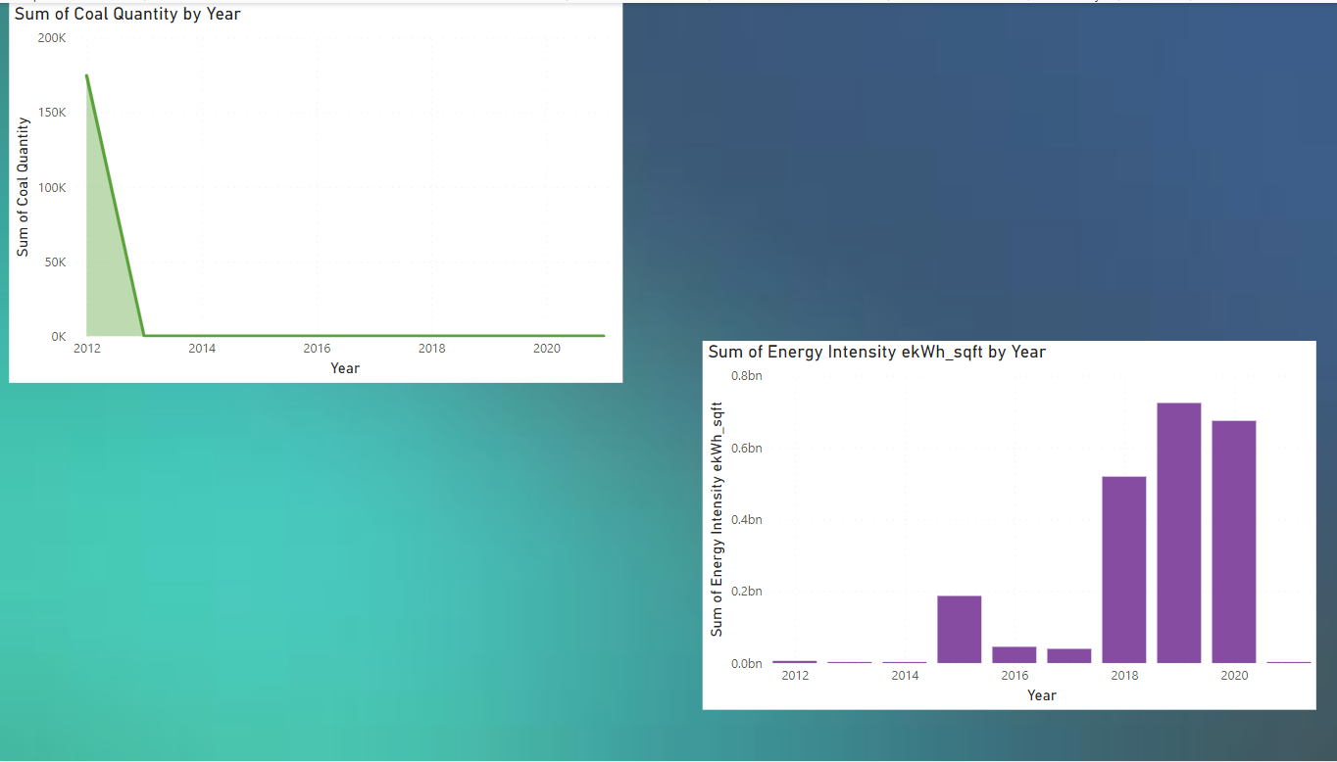
Coal usage:
Its decreasing from 2012

Slide 9
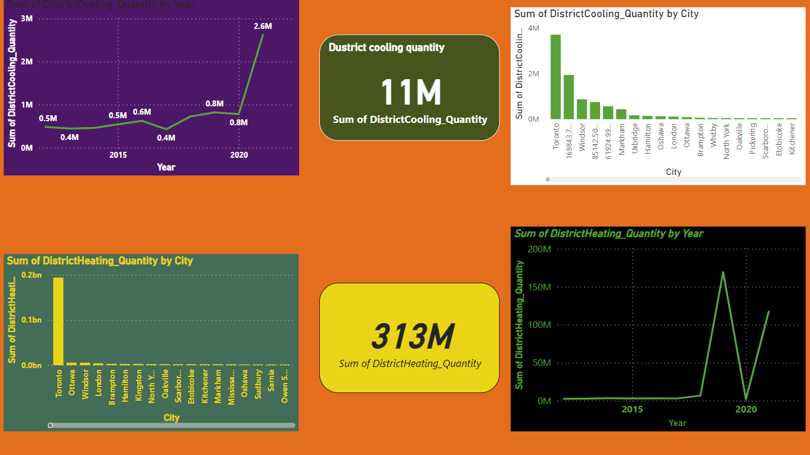
District heating and cooling:
Cooling effects recently increasing
Heating is stable for the year of 2019,but it was reducing phase in 2020

Slide 10
Suggestions:
We are seeing a continuous drop in GHG , this is because of following reasons:
  Drop in usage of
  Coal
  Wood
  Fuel oil
  Moving to alternative electricity sources like:
  Propane
  Natural Gas
From the above observation its clear that GHG can be reduced by reducing the usage of traditional(non renewable) energy to non-conventional energies like natural gas, Propane etc
We also have many non-conventional energies like
    Solar energy
    Wind energy
    Geo-thermal energy
    Hydel-power
    Bio-gas etc….
  With this growing need of electricity its not advisable to reduce our energy production but instead we can make use of non-conventional energy and achieve SUSTAINABLE DEVELOPMENT

Slide 11
THANK YOU

